Slide 1



Slide 3
Content
1. Overview
2. The Problem Addressed
3. Idea Tech
4. Personal Contributions
5. Functionalities
6. Guidelines
7. Live Demo
8. Questions

Slide 4
Overview

Slide 5
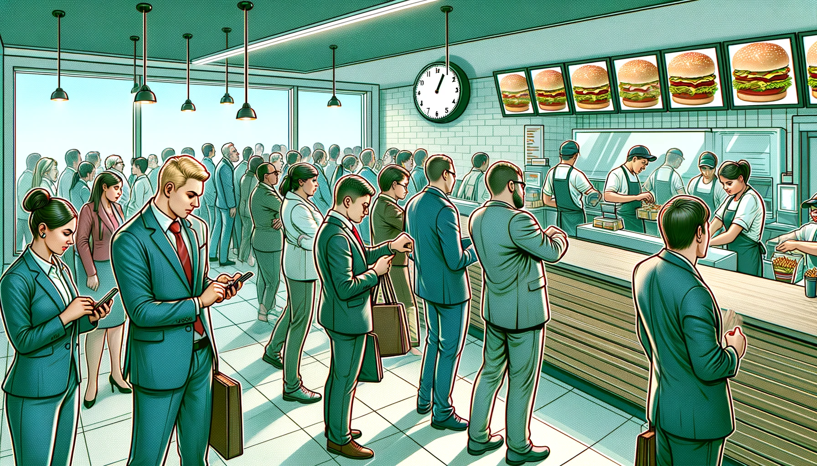
The Dilemma
Overv.

Slide 6
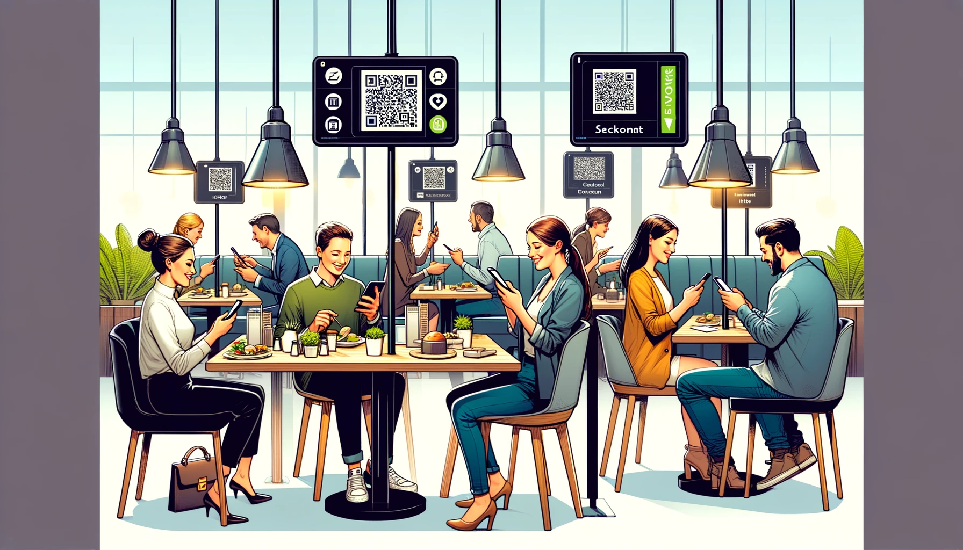
The Solution
Overv.

Slide 7
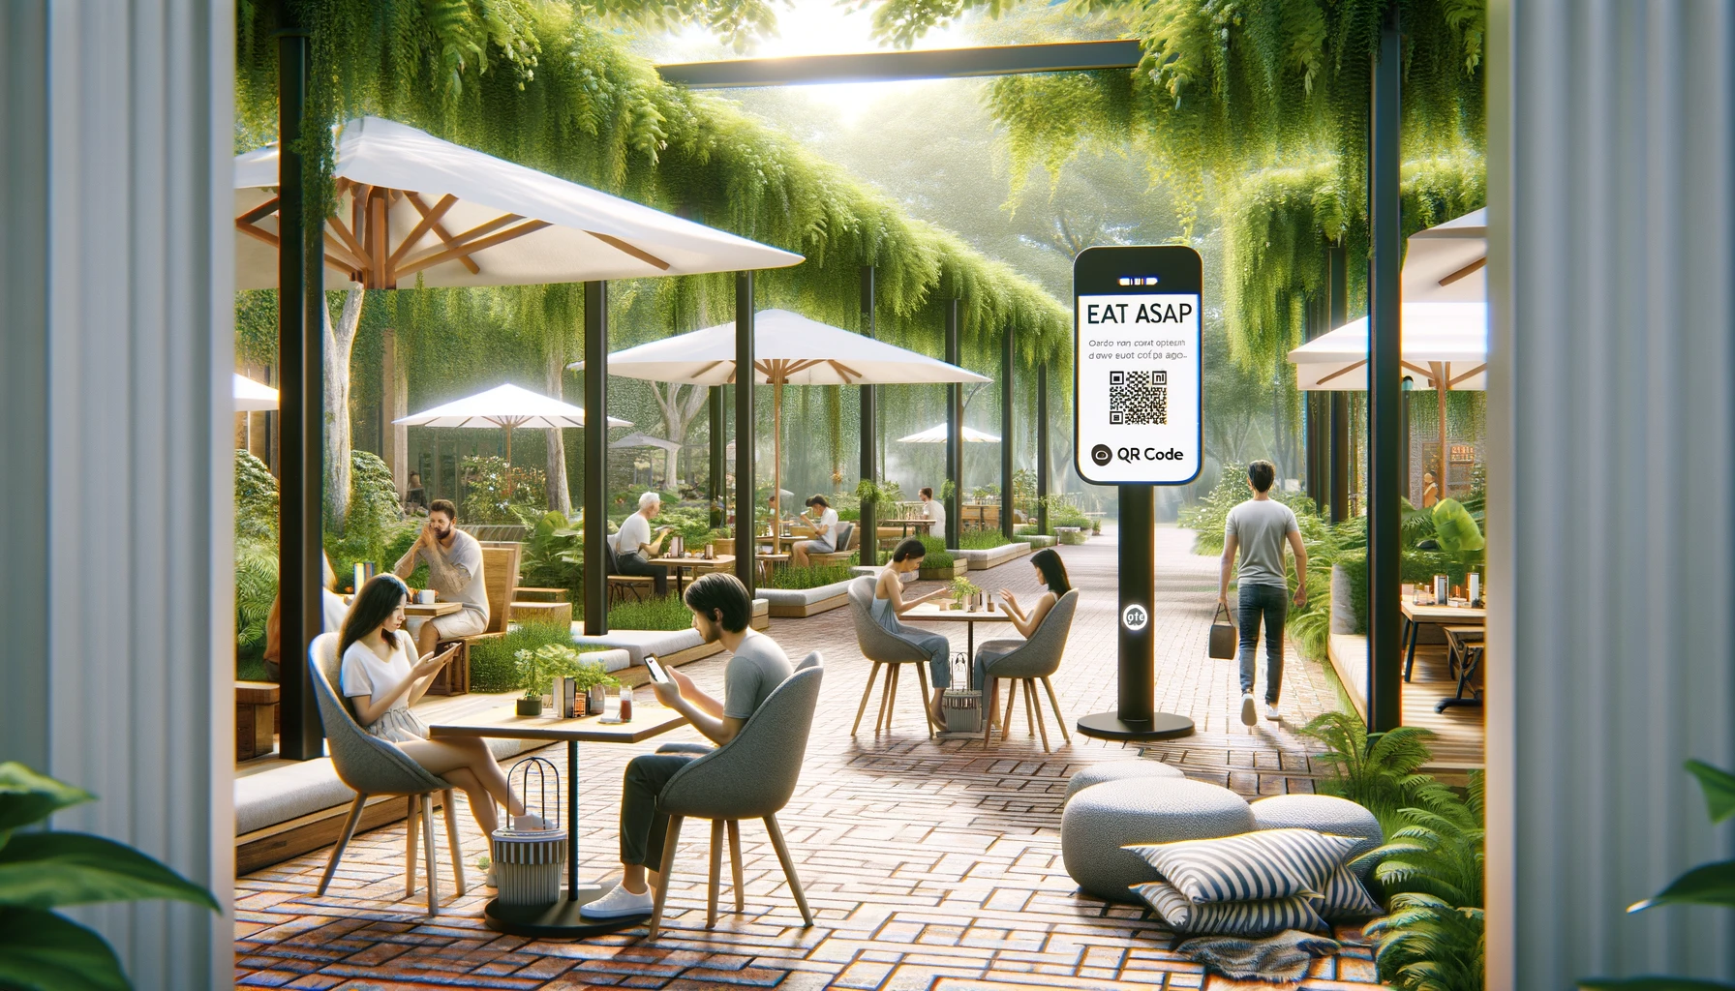
The Transformation with Eat ASAP
Overv.

Slide 8
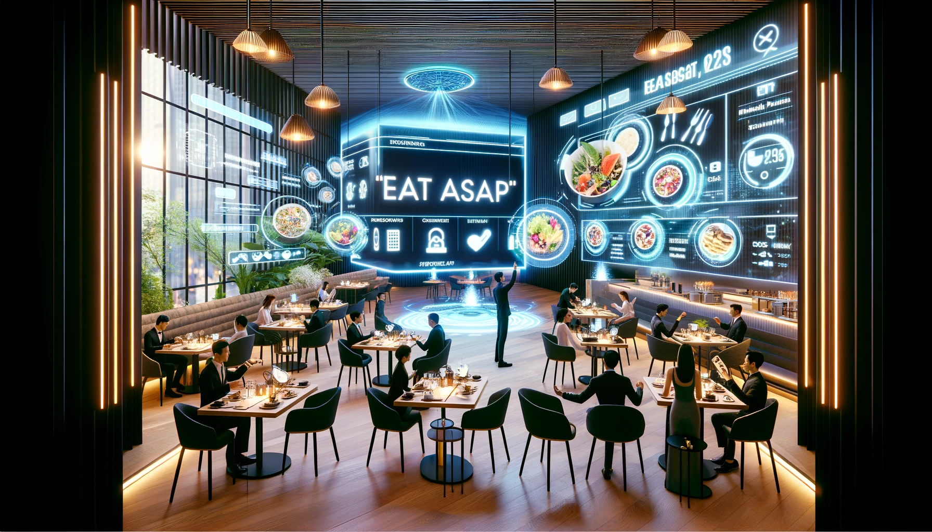
The Future with Eat ASAP
Overv.

Slide 9
The Problem Addressed
2/8

Slide 10
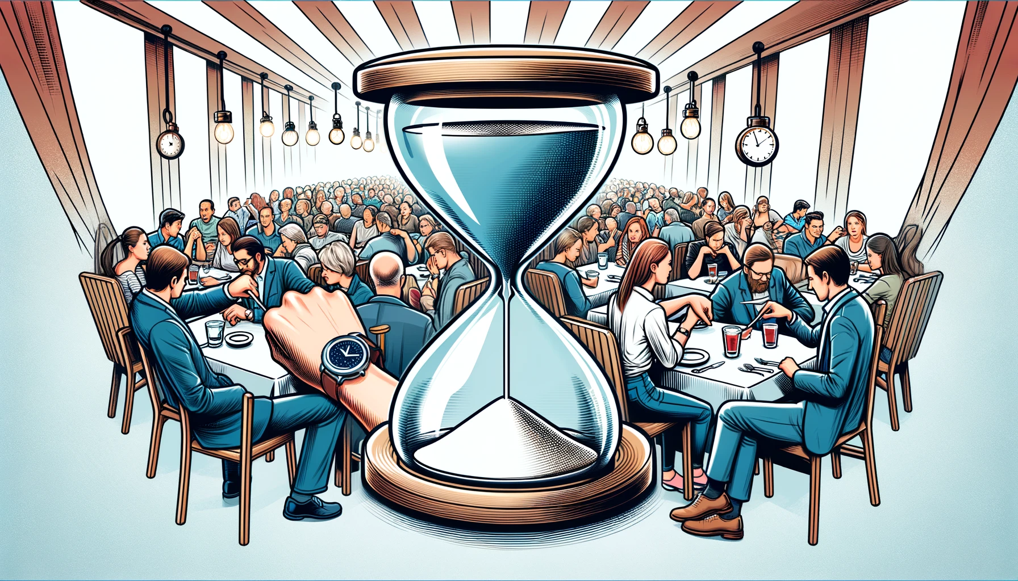
The Waiting Game
Probl.

Slide 11
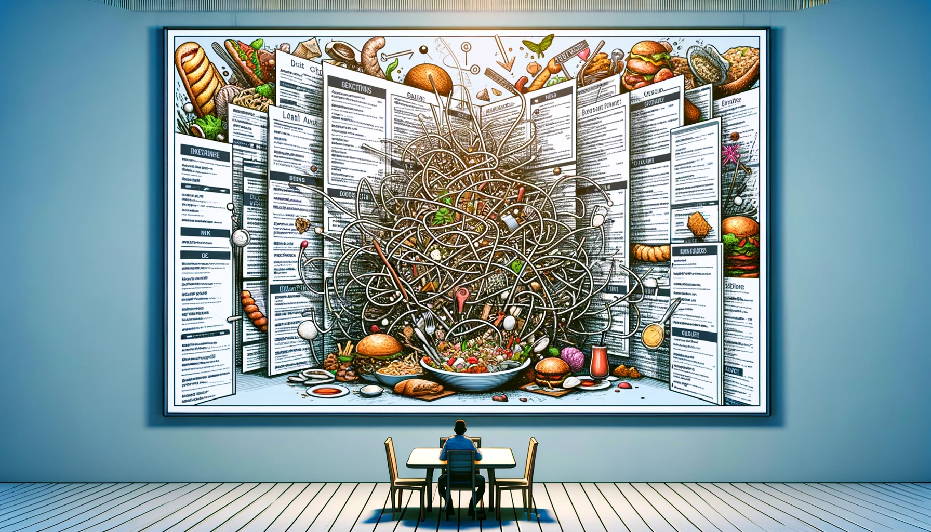
The Complexity of Choices
Probl.
Notes:
Change this

Slide 12

The Ripple Effect on Restaurants
Probl.

Slide 13
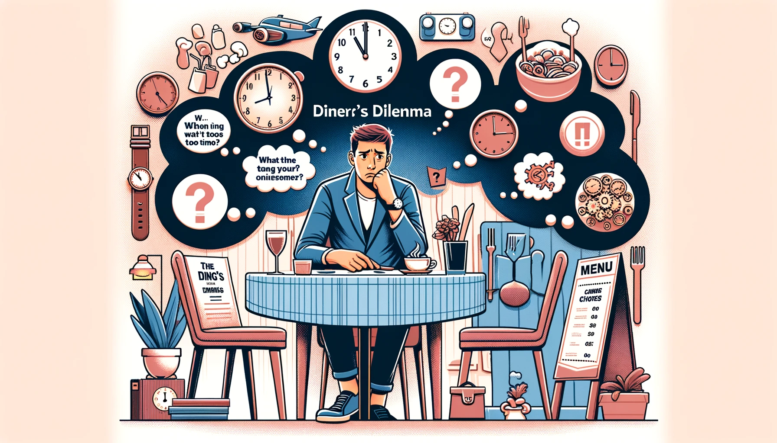
The Diner's Dilemma
Probl.

Slide 14
Idea Tech
3/8

Slide 15

Team Collaboration and Support
IdeaTech

Slide 16

GitHub for Organization and Coordination
IdeaTech

Slide 17
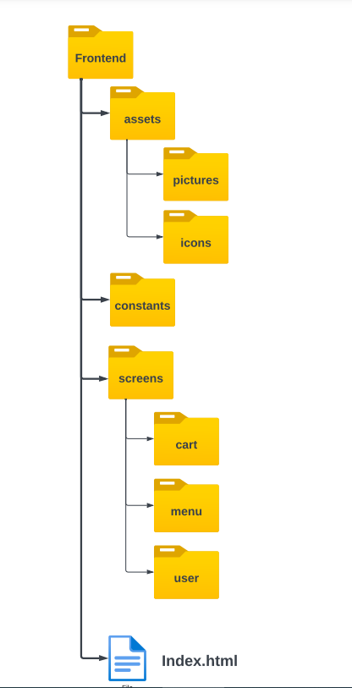
Project File Structure and UI/UX Design
IdeaTech

Slide 18

Learning and Growth
IdeaTech

Slide 19
Personal Contributions
4/8

Slide 20
Team Members
PersoContrib
Solomon
Ashot
Chen
Kawthar

Slide 21

Solomon's Welcoming Trio
PersoContrib

Slide 22
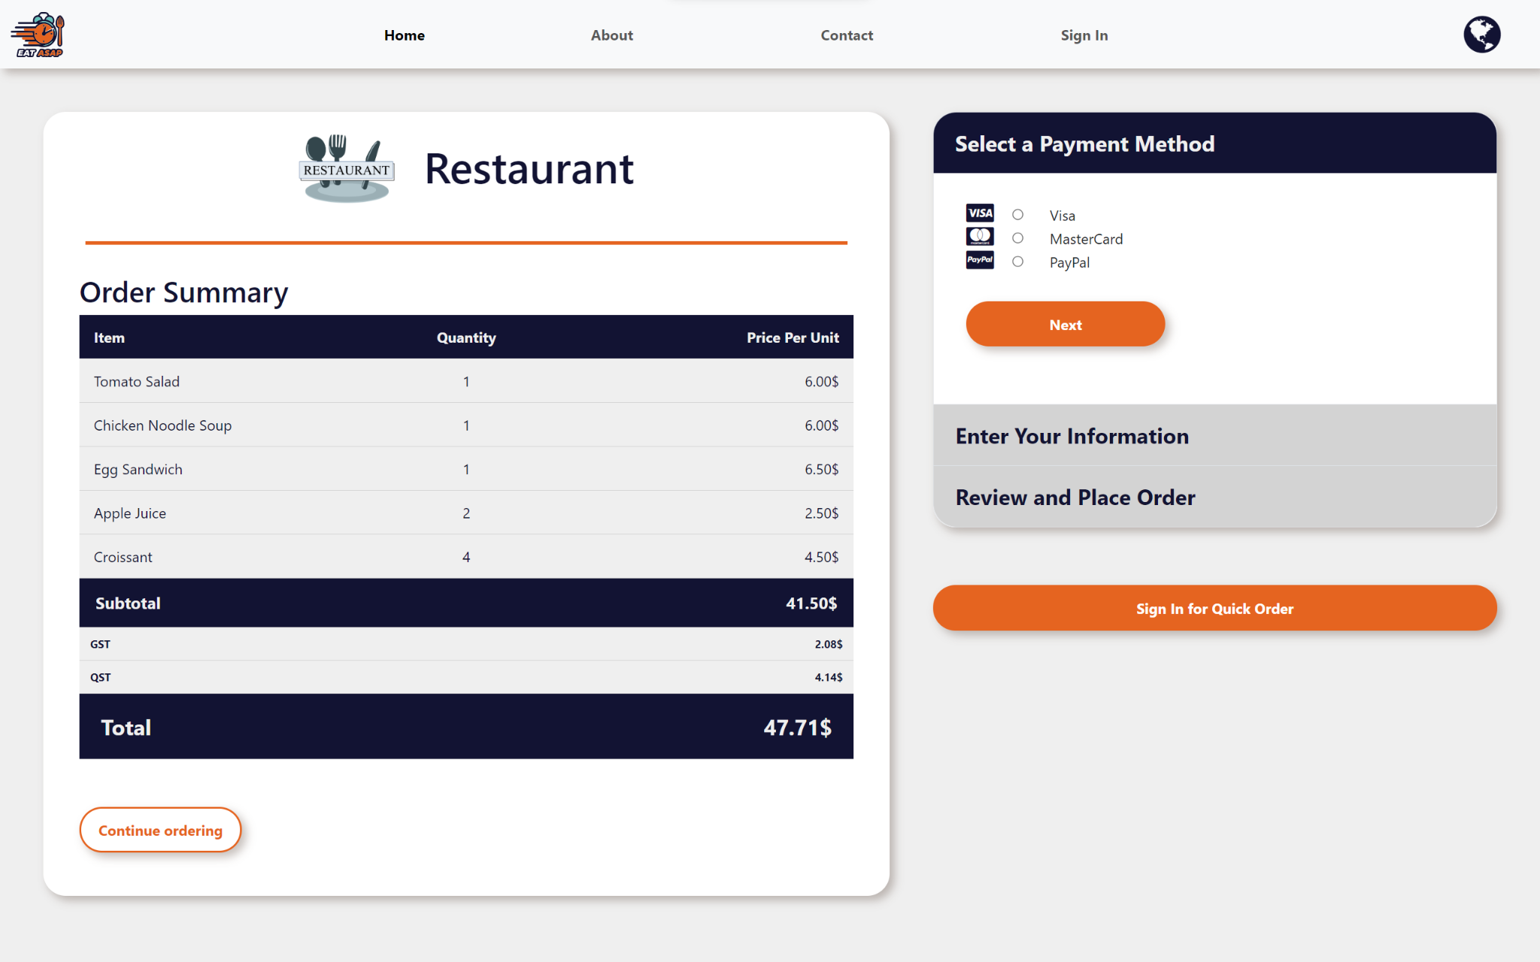
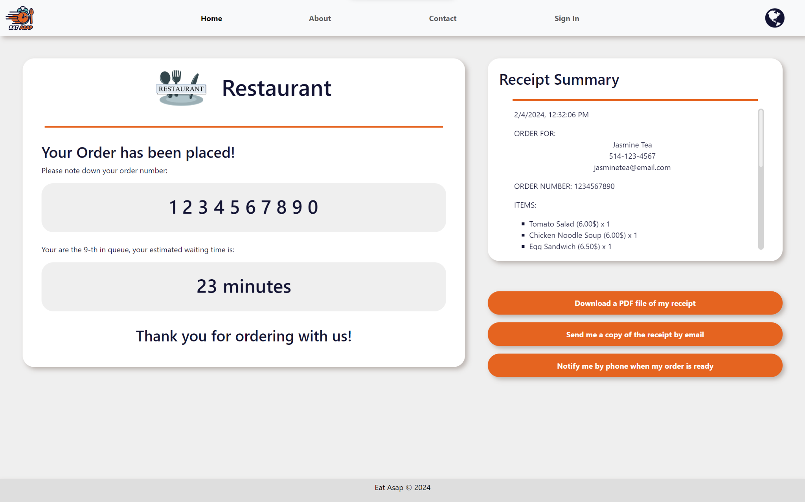
Chen's Checkout Processes
PersoContrib
Checkout page
Receipt page

Slide 23
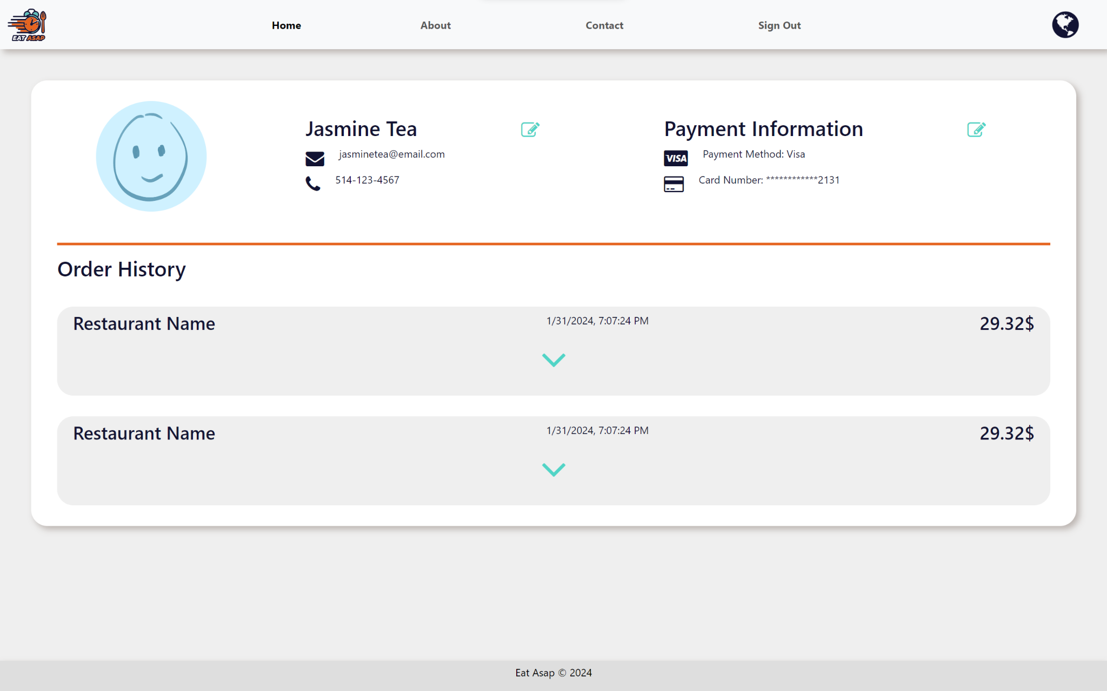
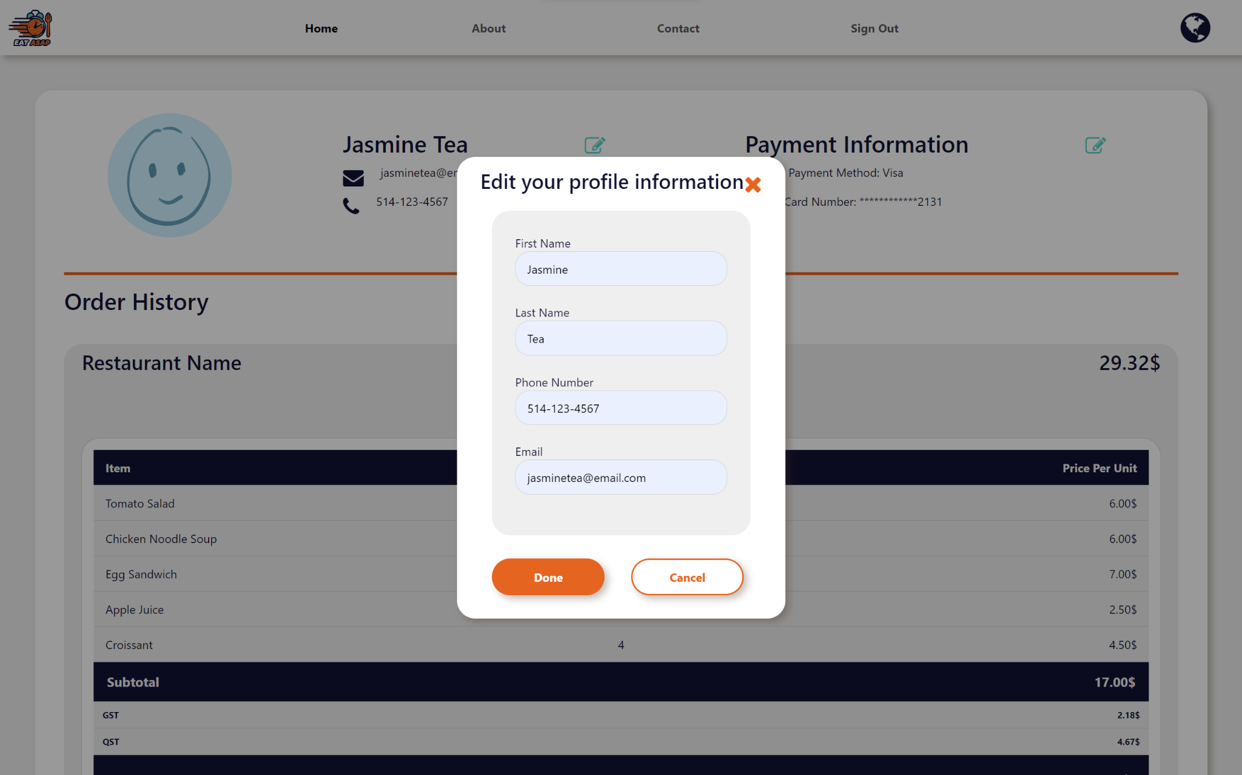
Chen's Customer Profile
PersoContrib
Customer Profile page

Slide 24
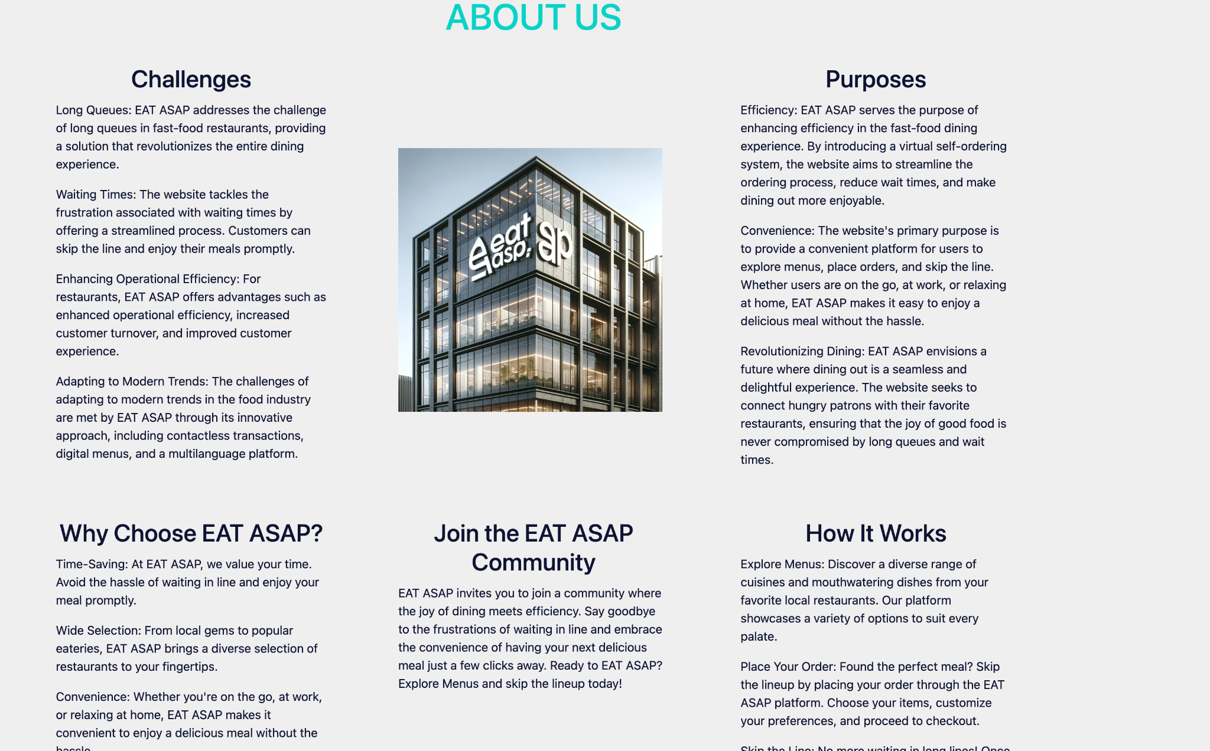
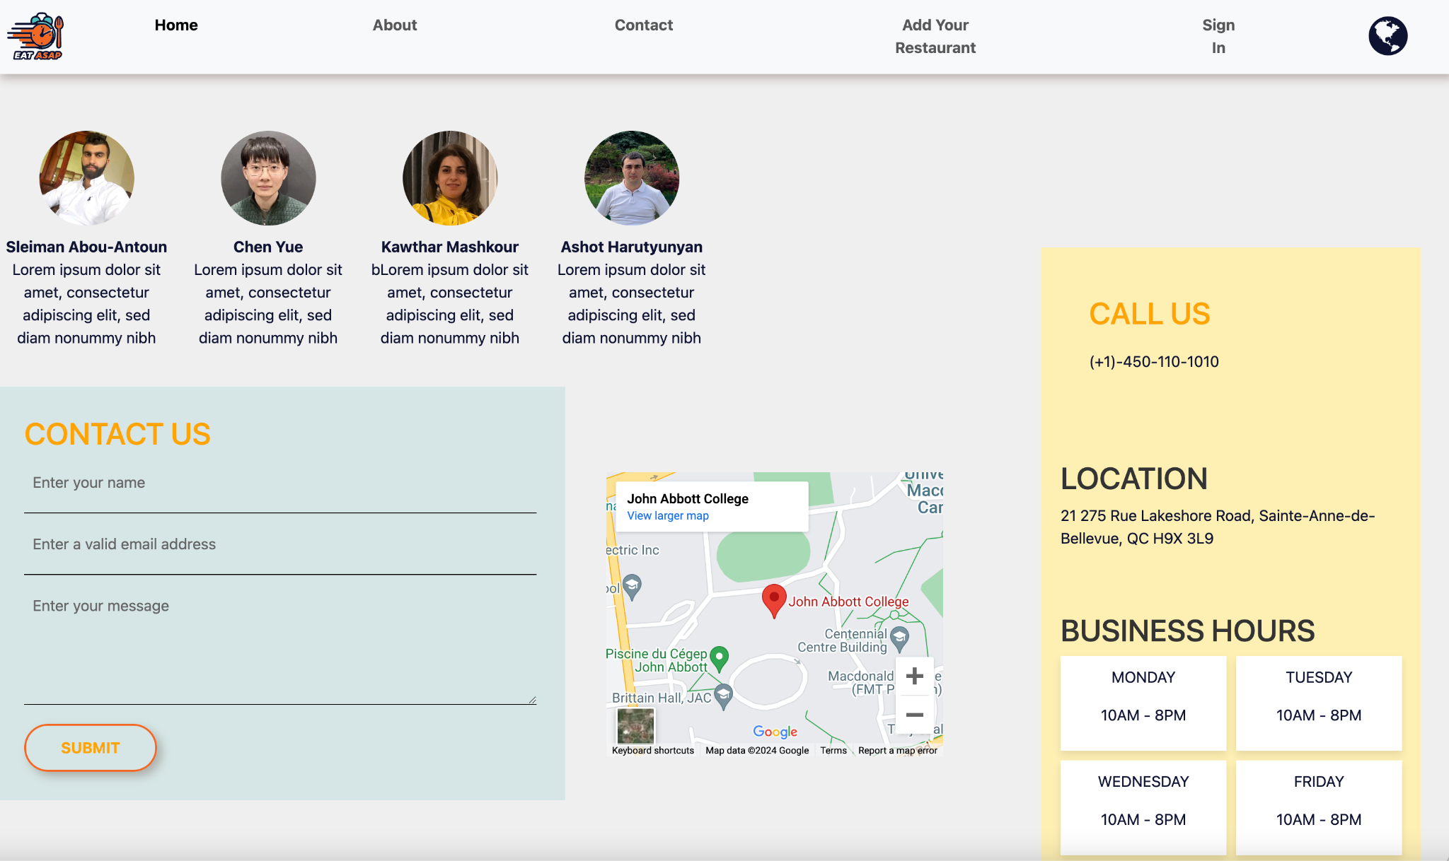
Ashot's Informative Pages
PersoContrib
‘I enriched our platform with depth and accessibility. The 'About Us' page I created offers insight into our mission and solutions to dining issues. The 'Contact Us' page provides a direct line for user inquiries, ensuring open communication channels between us and our users.’

Slide 25
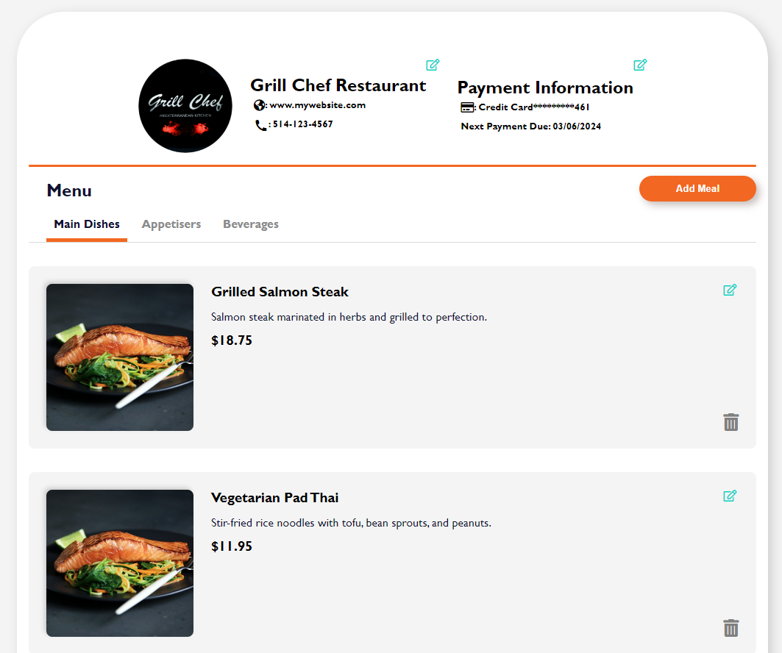
Kawthar's Interactive Selections
PersoContrib
‘My contributions are where user
choices come to life. I developed the
pages:
Restaurant Profile Page:
is a dedicated online space that provides information about a specific restaurant.
Menu Page:
Client place orders and view a summary of their order.

Slide 26
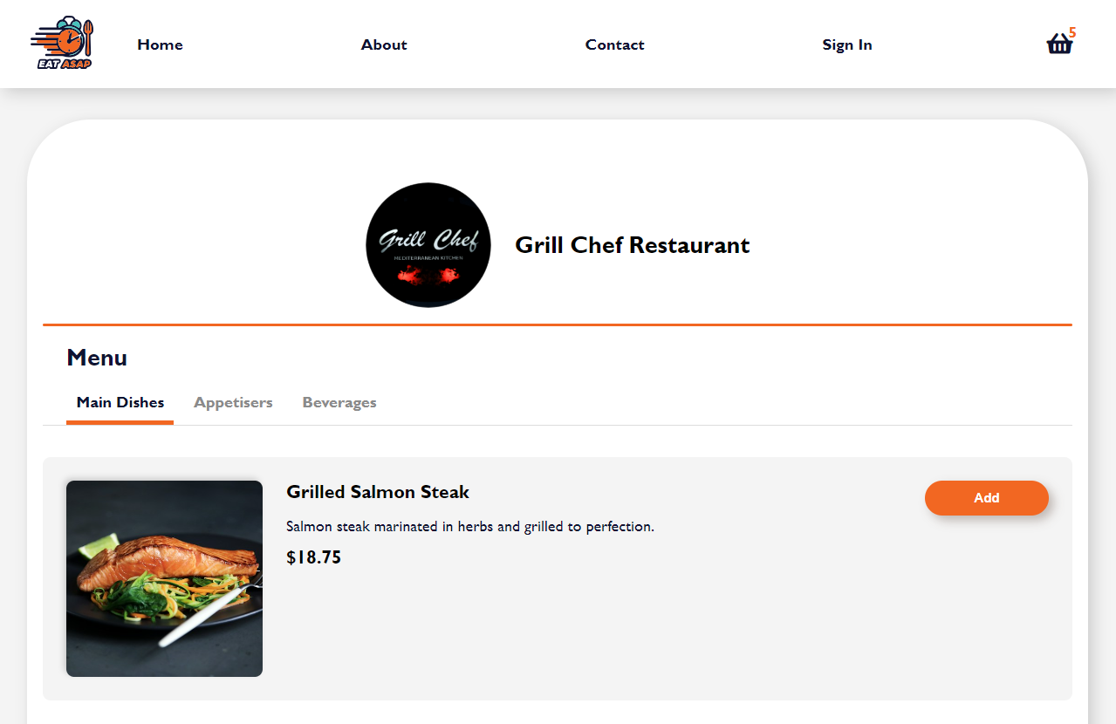
Kawthar's Interactive Selections
PersoContrib
Web Development Techniques/Features:
Events Listener
Window events (loading page)
Form events (submit)
Mouse events (click)
Web Storage
(localStorage, sessionStorage)

Slide 27
Functionalities
5/8

Slide 28
Functionalities
Function.
Enumerating the functions we used:
Registering, authentication, web storage…
1Registration form, 2tables, 3listing, 4dropdown list, 5buttons, 6apis, 7web storage, 8svg logo, 9.contactus, 10.aboutus, 11.size responsivenerss, 12video, 13audio, 14bonus(bootstrap)

Slide 29
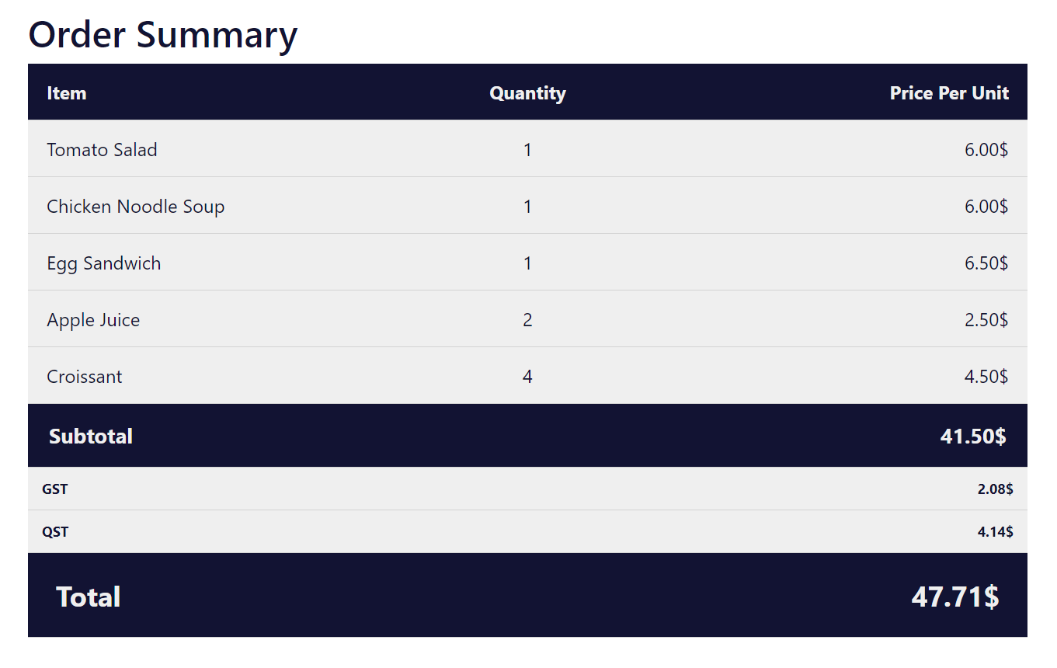
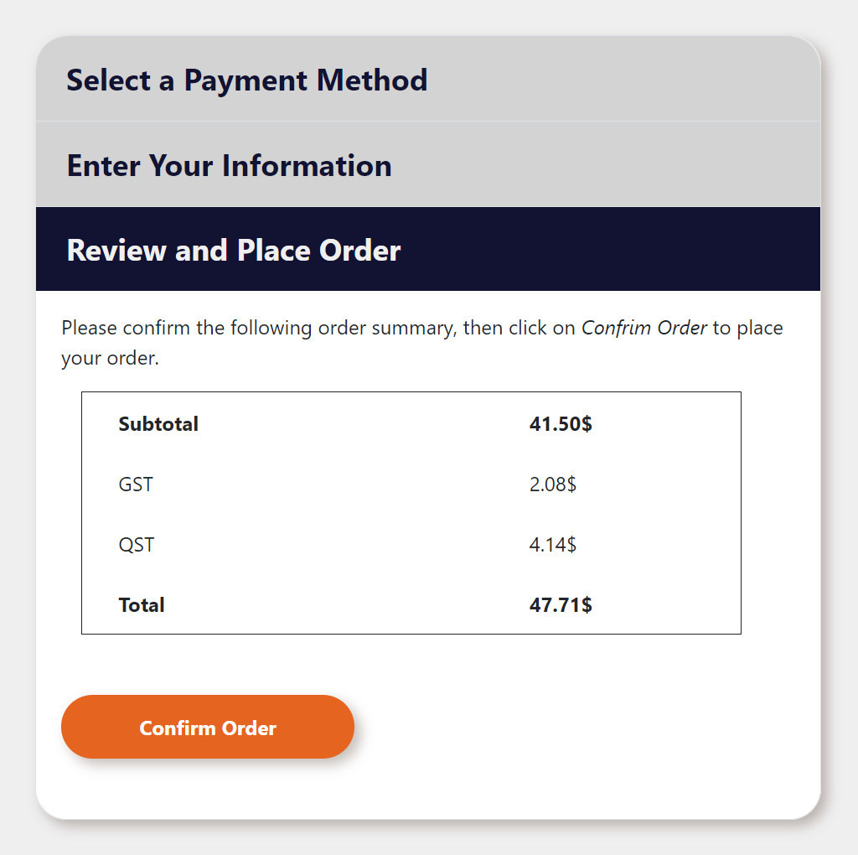
Functionalities
TABLES
Tables are used in the Checkout page to display the orders in the “Order Summary” and the “Review and Place Order” sections:

Slide 30
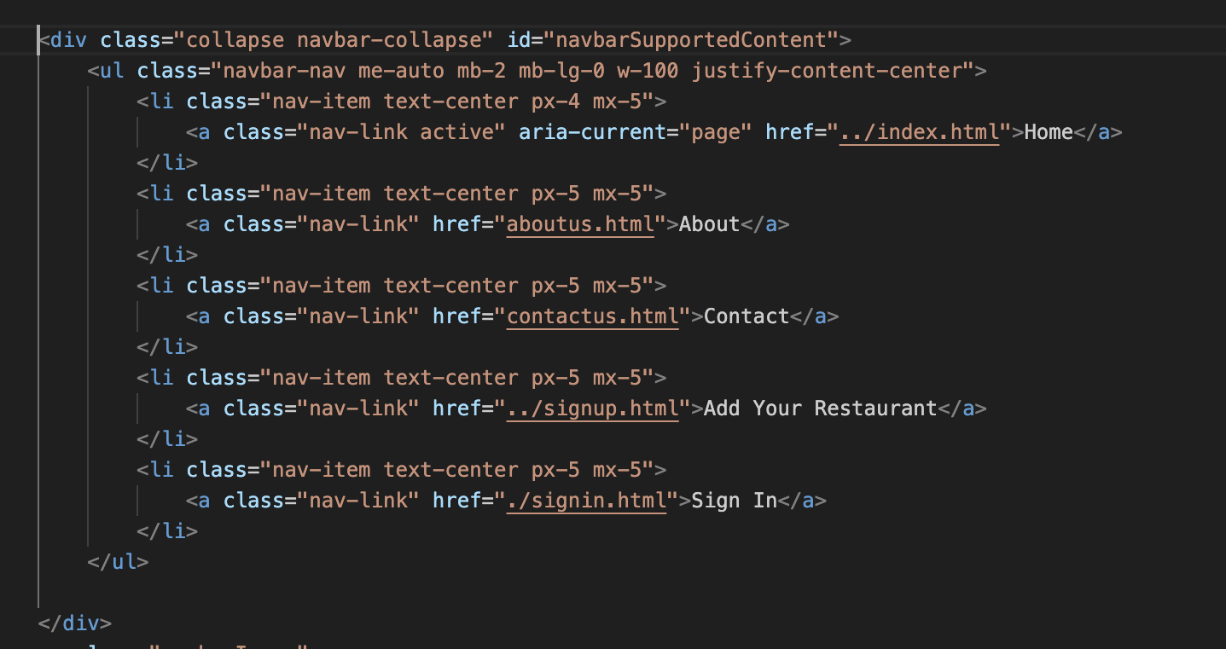
Functionalities
LISTING
HTML listing has been used for Navigation bar, using an unordered list to organize and display navigation links as list items. It's a common and effective way to present the main sections of a website, including 'Home', 'About', 'Contact', 'Add Your Restaurant', and 'Sign In' pages. Each list item is styled with padding and margin for visual appeal and spaced evenly for a balanced look. The 'nav-link active' class on the 'Home' link suggests that it's the currently active page, providing a visual cue to users. This approach ensures a user-friendly experience, guiding visitors intuitively through the site's content.

Slide 31
Functionalities
DROP DOWN LIST
<select name="Business Type" required>
<option value="NA" disabled selected>Select business type</option>
<option value="fast_food">Fast Food</option>
<option value="casual_dining">Casual Dining</option>
<option value="fine_dining">Fine Dining</option>
…
<option value="pizzeria">Pizzeria</option>
</select>

Slide 32
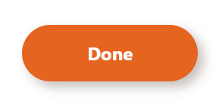
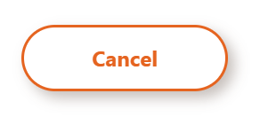
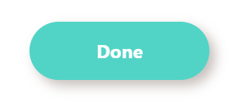
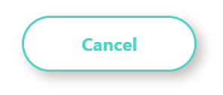
Functionalities
BUTTONS
Buttons are used throughout out website on all pages.
We mainly have two variations of styling for our buttons.
Variation 1
Normal:
Hover:
Variation 2
Normal:
Hover:

Slide 33
Functionalities
APIs
<head>
<script async src="https://maps.googleapis.com/maps/api/js?keyAPIKEYS=&callback=console.debug&libraries=maps,marker&v=beta"></script>
<style> gmp-map { height: 50%; width: 50%; margin: 20px auto; }
</head>
<body>
<gmp-map center="45.40653991699219,-73.94169616699219" zoom="14" map-id="DEMO_MAP_ID">
<gmp-advanced-marker position="45.40653991699219,-73.94169616699219" title="My location">
</gmp-advanced-marker>
</gmp-map>
</body>

Slide 34
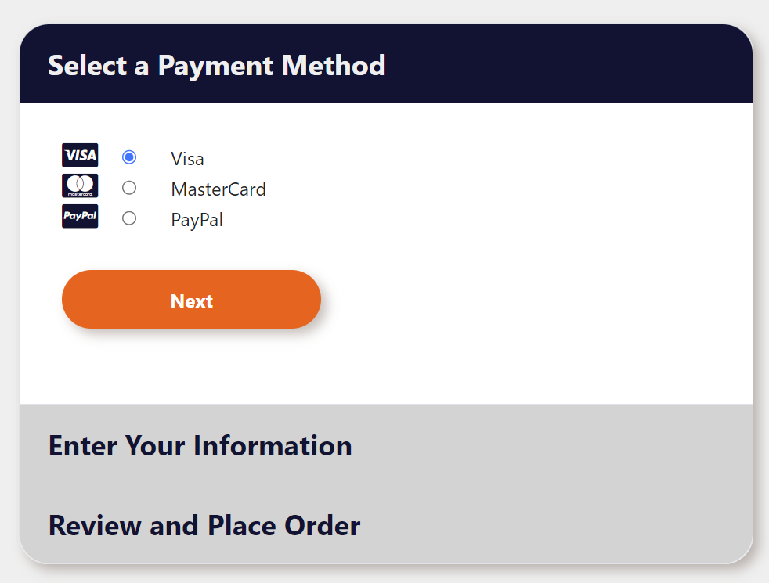
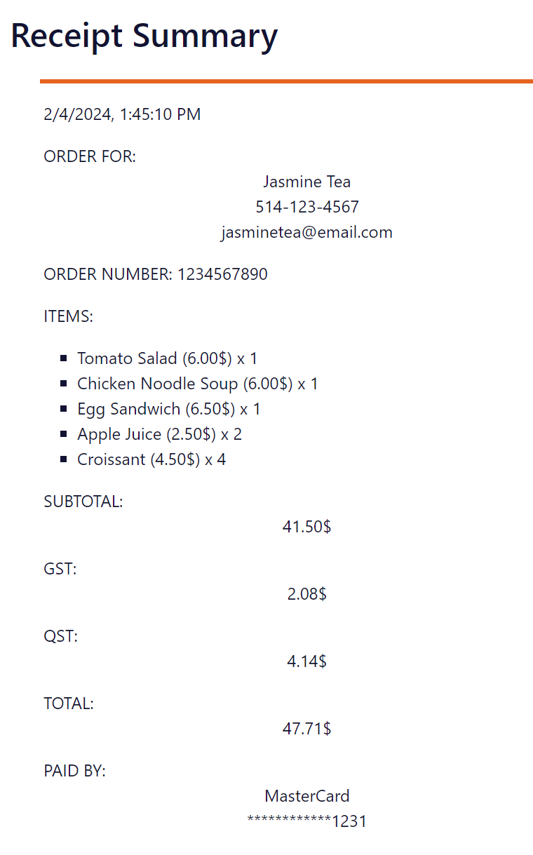
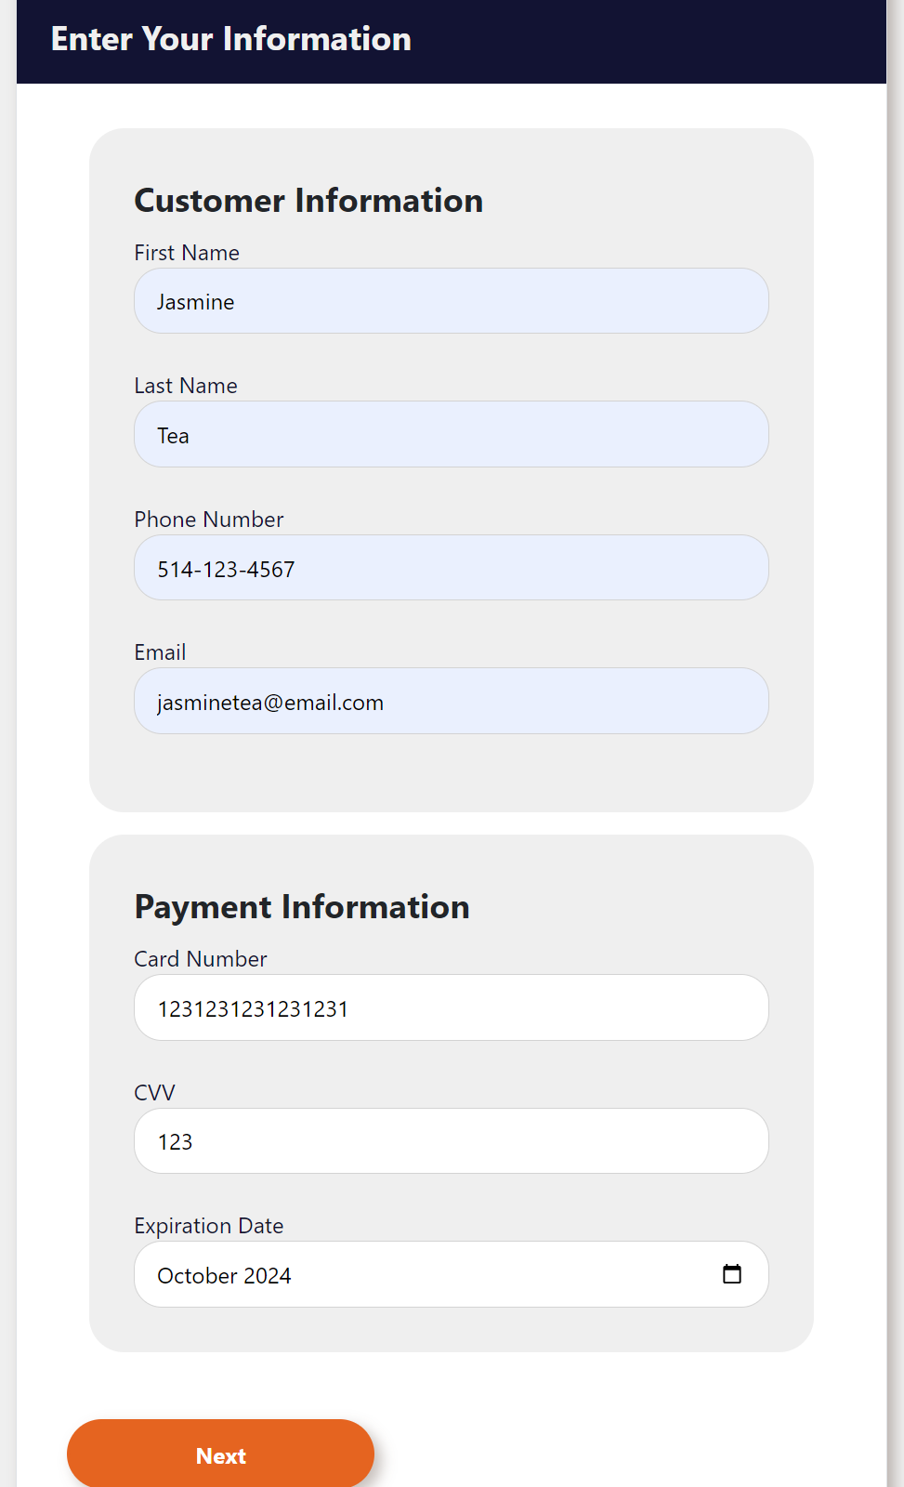
Functionalities
WEB STORAGE
Webstorage was used to bring the user’s information that they filled from the Checkout page onto the receipt on the Receipt page.
Each time the user press the next button, a key-value pair of the value filled in the form is saved to local storage, for example:
var firstName = $('#firstName').val();
localStorage.setItem("firstname", firstName);
Then on the receipt, the information is retrieved from the local storage to display on the receipt:
var firstName = localStorage.getItem("firstname");
var lastName = localStorage.getItem("lastname");
$('#customerName').html(firstName + " " + lastName);

Slide 35
Guidelines

Slide 36

Guidelines
SVG LOGO
Meaningful:

Slide 37
Guidelines
CONTACT US
This is the 'Contact' page for the website, designed to foster communication between the platform's team and its users. On the webpage, there are four circular profile pictures of team members, which suggests a personalized approach and this personalization can help users feel more connected to the EAT ASAP brand by knowing who is behind the service.The Contact Us section, strategically placed for visibility, invites users to engage with the EAT ASAP team by entering their name, email, and a message.webpage includes essential contact information such as a phone number and physical address, reinforcing the transparency and accessibility of the service. The integration of a Google Maps iframe also provides users with a convenient, visual way to locate the EAT ASAP business.Overall, the Contact page is thoughtfully designed to be welcoming and functional, aligning with the EAT ASAP brand's focus on efficiency and customer service.

Slide 38
Guidelines
ABOUT US
This page is designed to inform visitors about the mission, values, and operational aspects of EAT ASAP.The "About Us" section is divided into three main parts:
Challenges: This part of the page addresses the common issues faced by fast-food restaurant customers, such as long queues and waiting times. EAT ASAP positions itself as a solution to these problems by offering a streamlined ordering process that enhances the dining experience.
Purposes: Here, the page outlines the primary objectives of EAT ASAP, highlighting the benefits such as efficiency, convenience, and a vision to revolutionize dining. The platform aims to provide a seamless connection between customers and their favorite restaurants, ensuring a hassle-free dining experience.
How It Works: This section gives a brief explanation of the EAT ASAP service process. It details how users can explore menus, place orders, and skip the line, thereby saving time and enjoying a convenient meal ordering system.

Slide 39
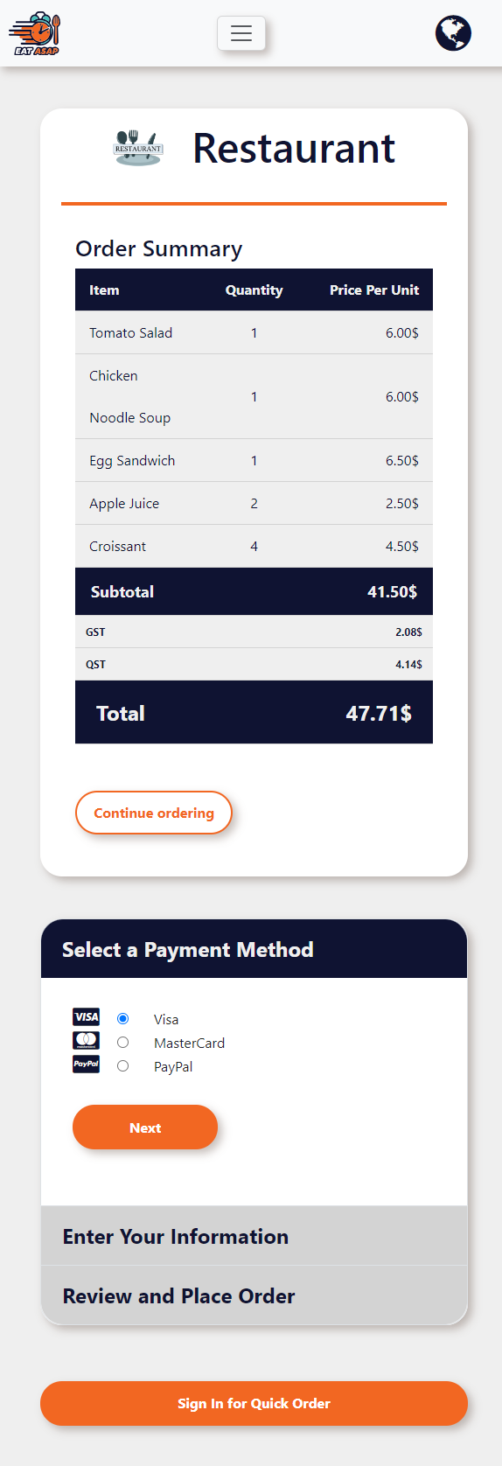

Guidelines
RESPONSIVENESS
Flexbox was used to make the overall page responsive. For example, in the Checkout page, the payment and customer information section at the right side of the page will wrap under the order summary section when the screen width is small

Slide 40

One embedded video:
VIDEO

Slide 41
Guidelines
VIDEO
One embedded audio: Kawthar

Slide 42
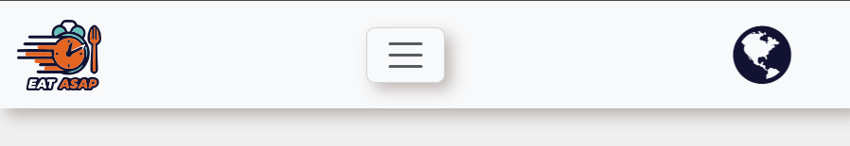
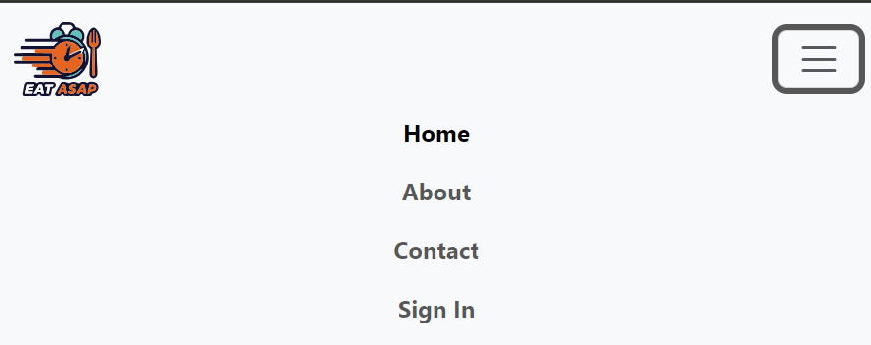
Bonus: Bootstrap (Burger Menu + Responsive)
Guide.

Slide 43
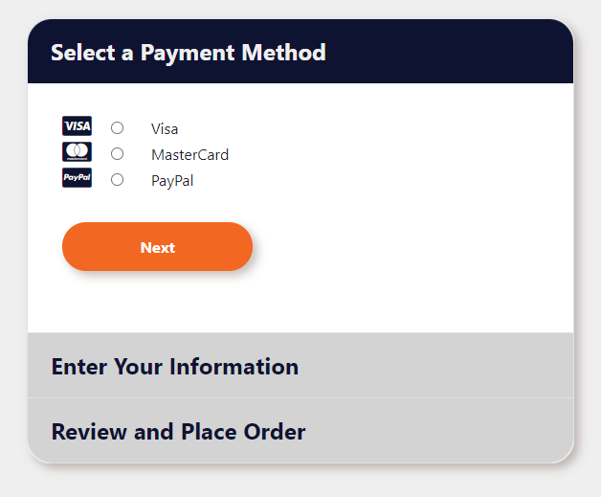
Guidelines
BONUS
BOOTSTRAP
Bootstrap was also used to create the accordion on the checkout page.
Some Bootstrap classes used:
accordion
accordion-items
accordion-collapse
collapse
show

Slide 44

Live Demo

Slide 45
Answering Questions

